Slide 1
Home Loan Case Study
Capgemini Training Group - 2

Slide 2
Members
Nilay Saxena
Srajan Samaiya
Sakhamuri Sai Hemanth
Rakesh Thummalacharla
Upadhyayula Sai Sharmila
Sagar Malakar
Hanmapur Ramya
Ritika Purohit

Slide 3

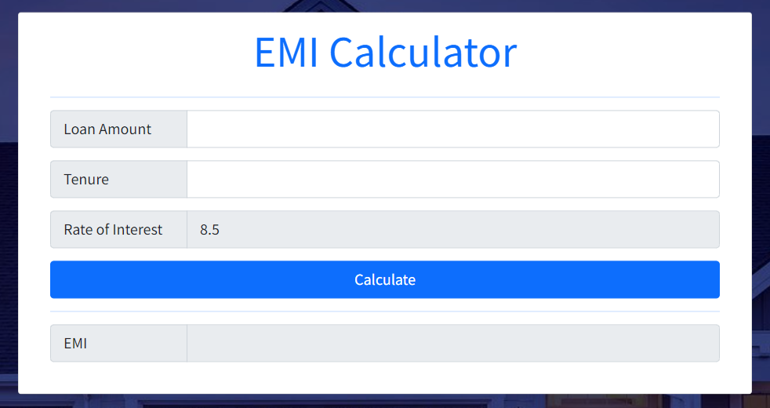
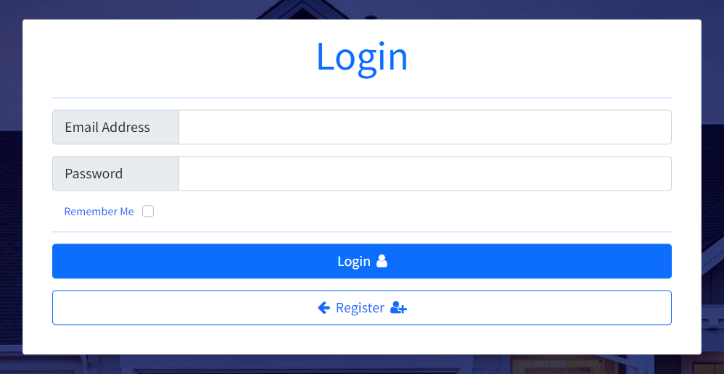
Introduction
This project is a Home Loan Case Study done by Training group 2. The project was done on Visual Studio 2022 using ASP.NET MVC and Entity Framework. The Software Development Life Cycle model used was Iterative Waterfall Model.
The approach used for the creation of the database was Code-First using Entity Framework.
3

Slide 4
Timeline
Planning
The discussion of the case study and which SDLC model to use for development.
Database
Creation of the database using Entity Framework Code First Approach.
Development
Development of different modules by the team members
Integration
Finalization
Integration of different modules into the project and error handling.
Final changes made along with the styling of the entire application.

Slide 5
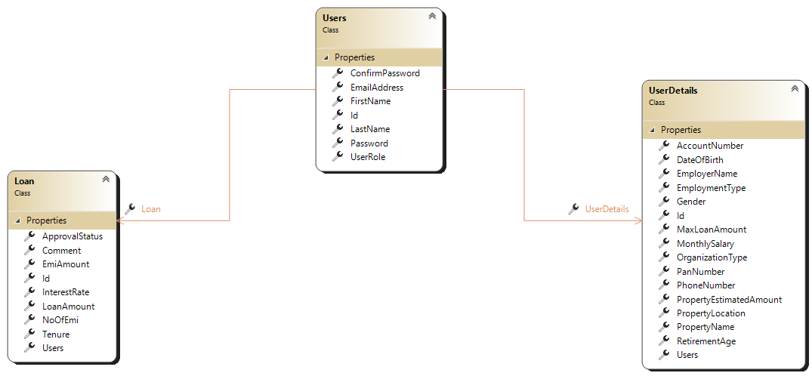
Class Diagram

Slide 6
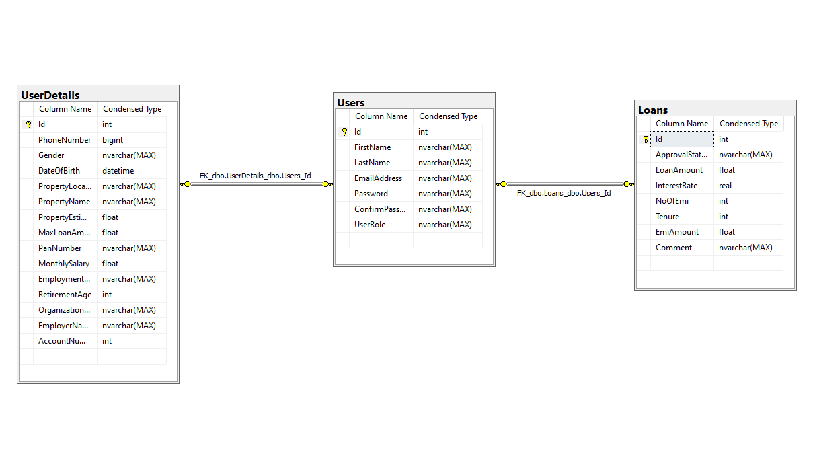
Entity Relationship Diagram

Slide 7
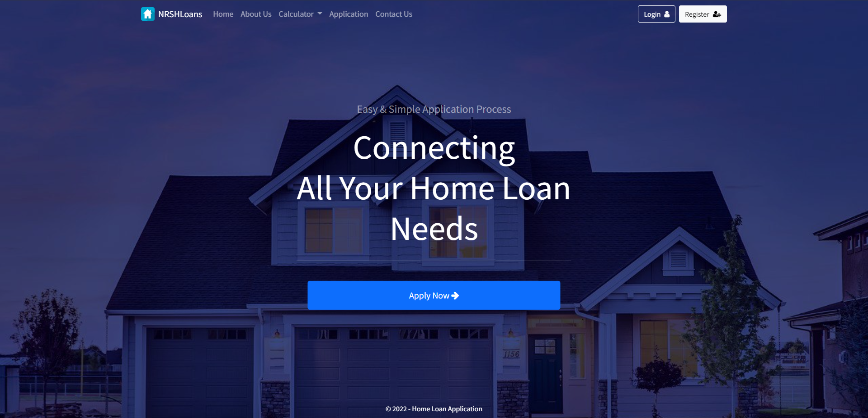

Slide 8
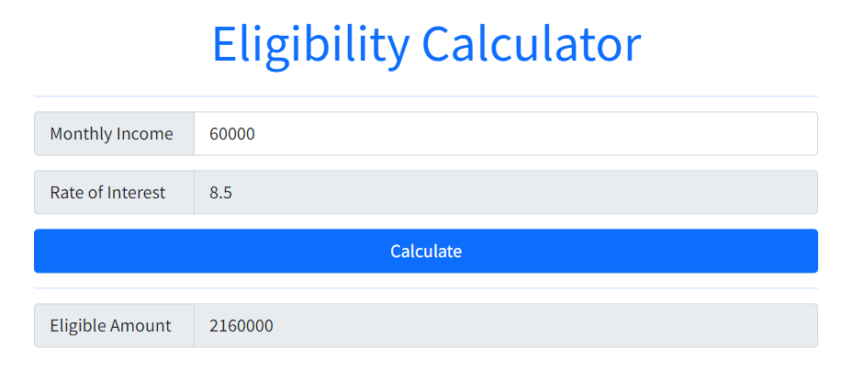
$$Eligible Amount=0.6 ∗60 ∗Monthly Salary$$

Slide 9
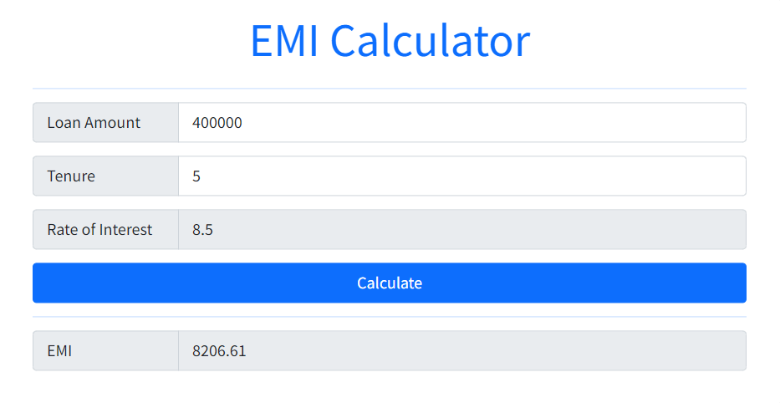
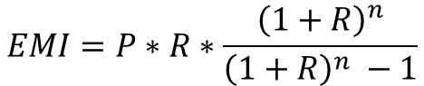
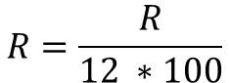
$$EMI=P∗R∗\frac{{\left(1+R\right)}^{n}}{{\left(1+R\right)}^{n} −1}$$
$$R=\frac{R}{12 ∗100}$$

Slide 10
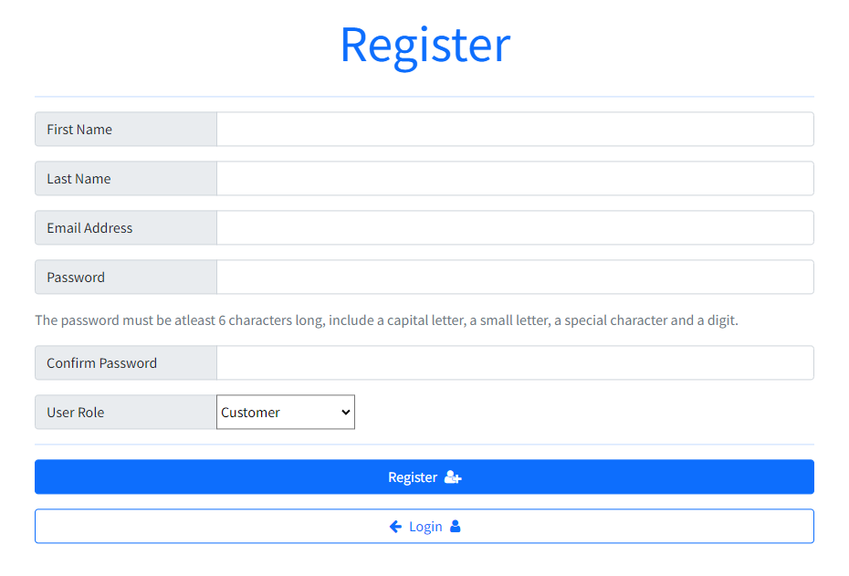
Choose between Customer or Admin

Slide 11
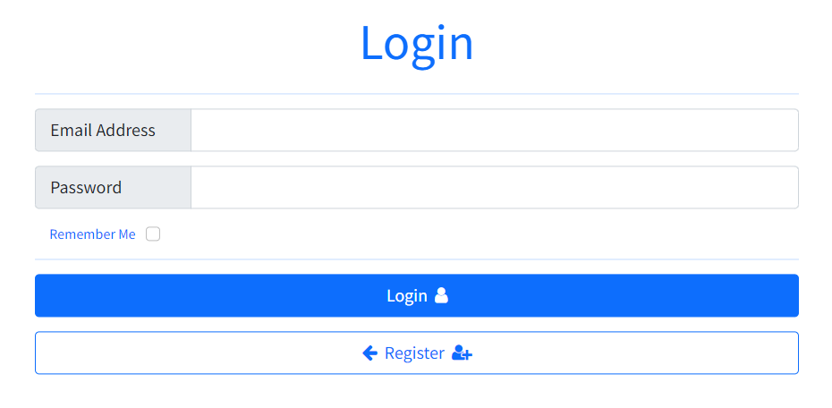
Creates a persistent cookie

Slide 12
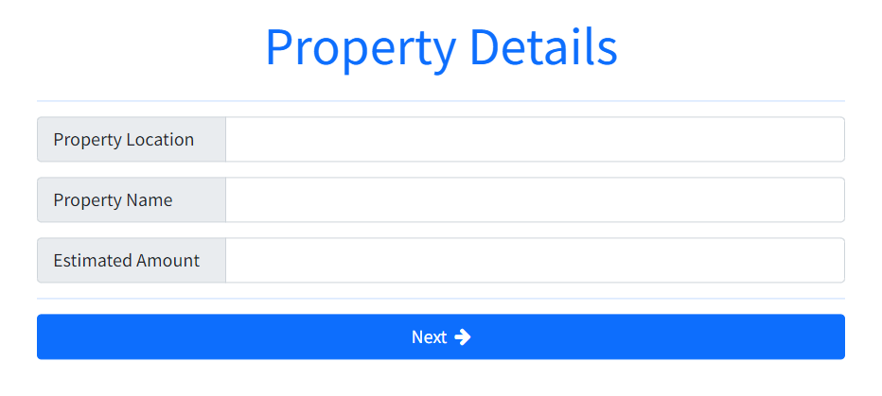
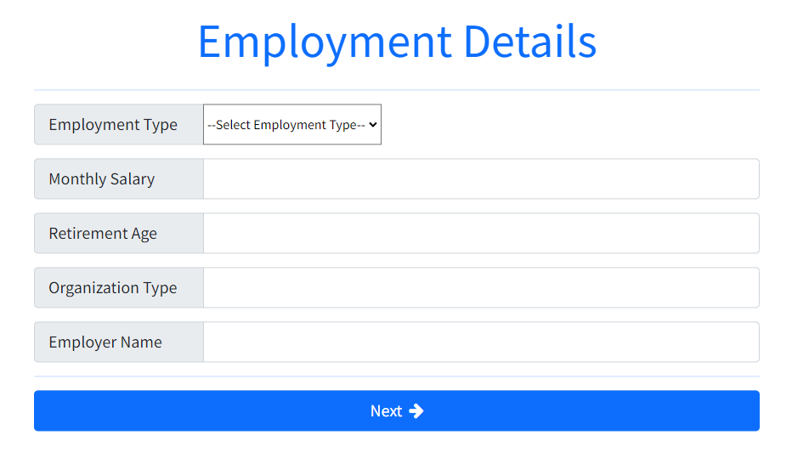
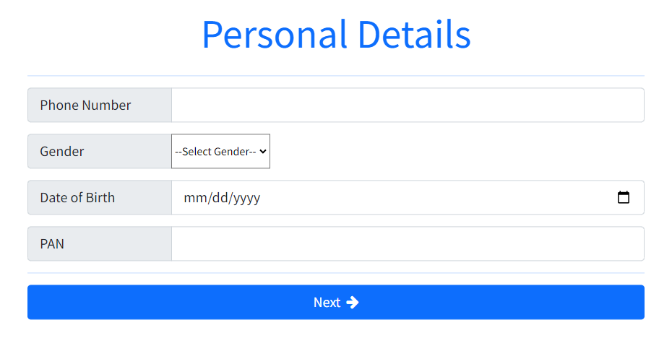
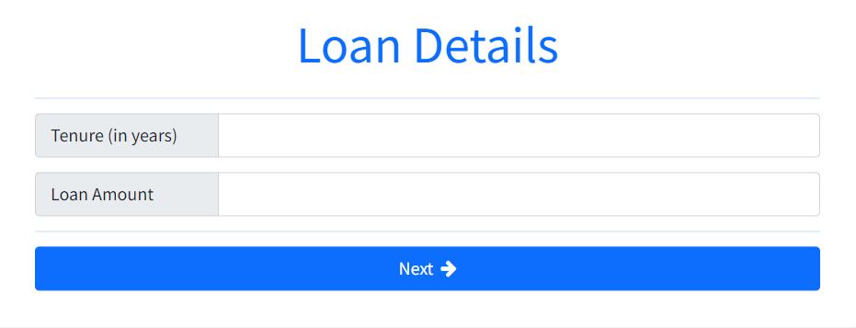

Slide 13
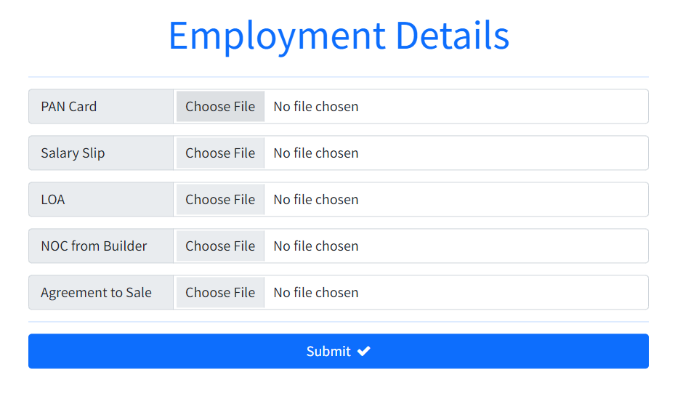

Slide 14
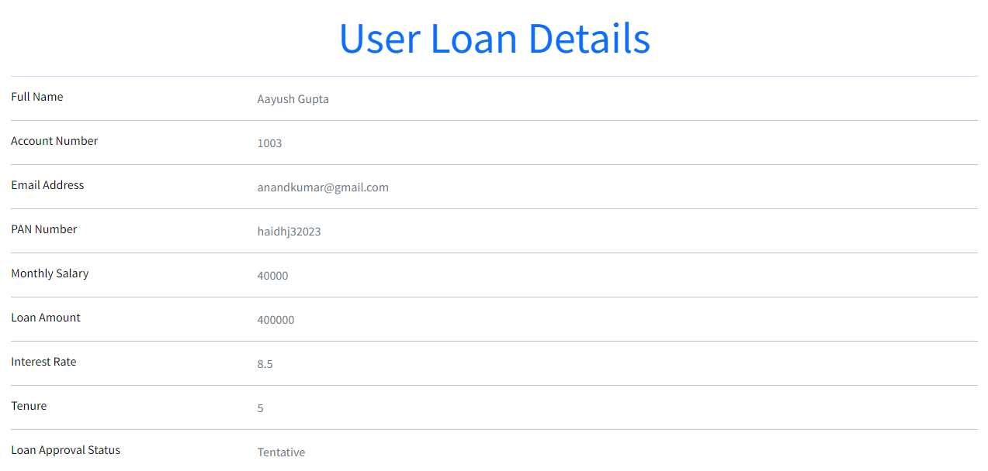
Will change when Admin rejects or approves the loan

Slide 15
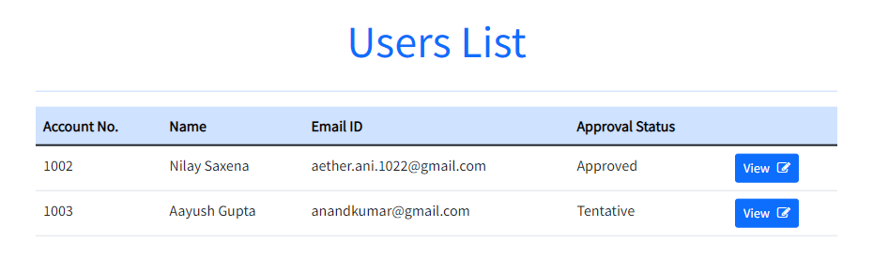

Slide 16
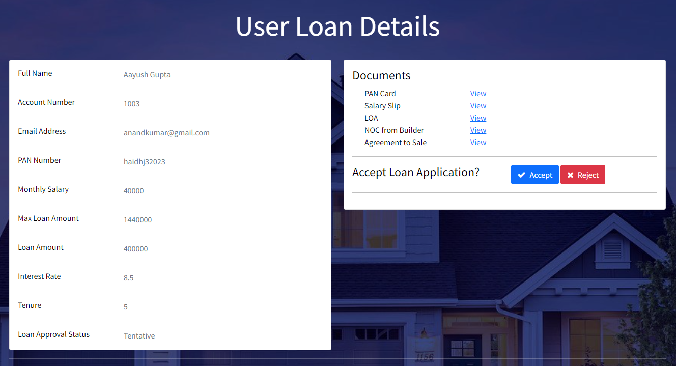

Slide 17
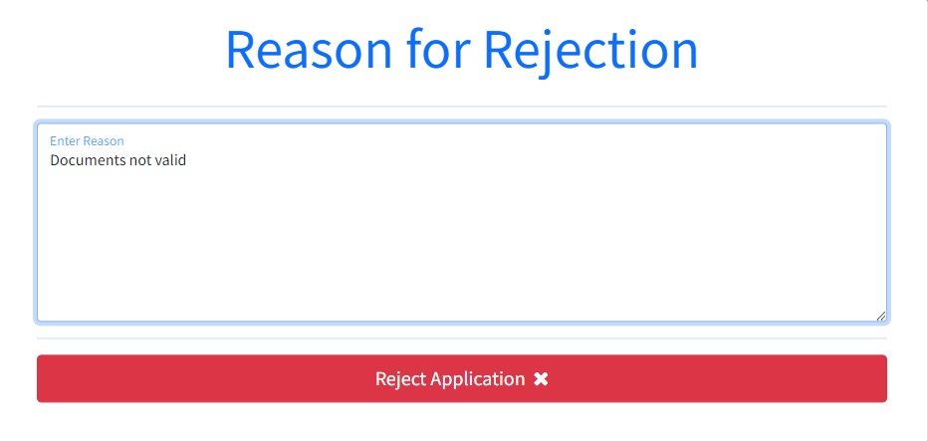
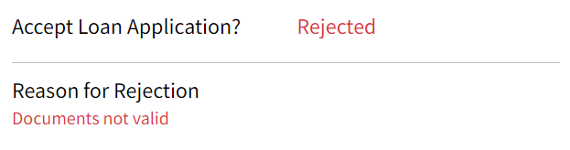

Slide 18
Thank you

